Slide 1
Password Application
By: Brian Nguyen, Brandon Chau, DeMarco Green

Slide 2
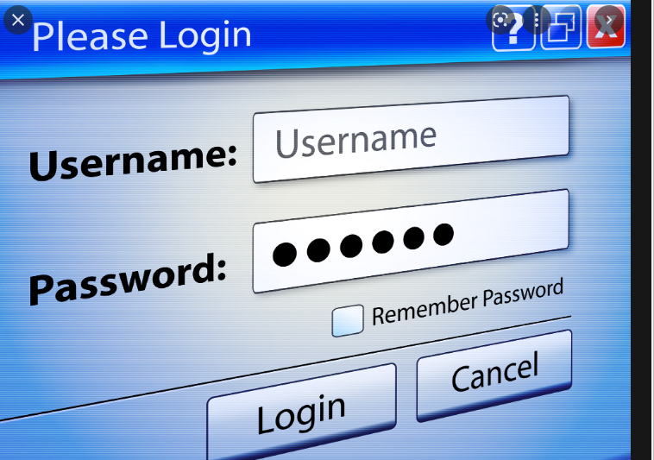
Describe Project
Used Most concepts from this class:
Try Except, Files reading, appending and writing, Global Variables, Dictionaries, Libraries, Modules, Tkinter for GUI, Functions, Loops, list, list comprehensions, list functions
Adding app, password, and username
Encryption
Notes:
Brian

Slide 3
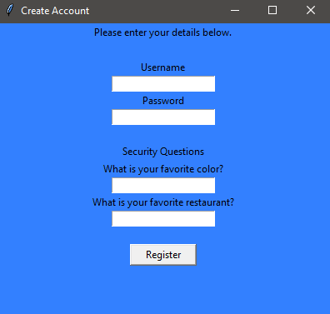
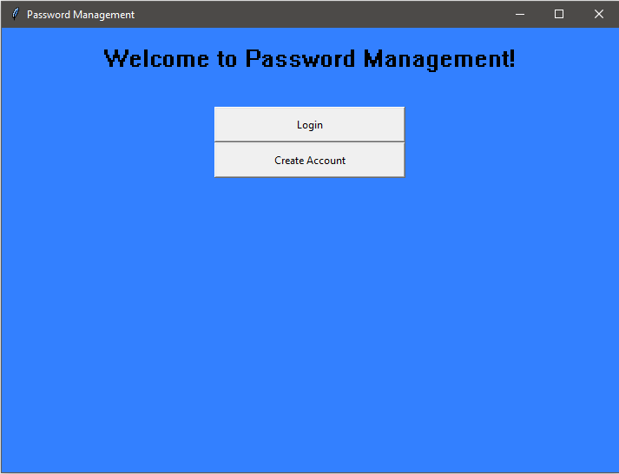
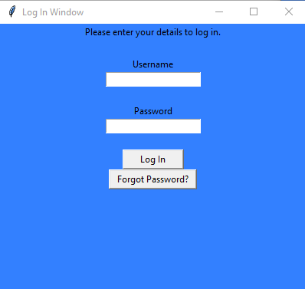
GUIS
Notes:
Demarco

Slide 4
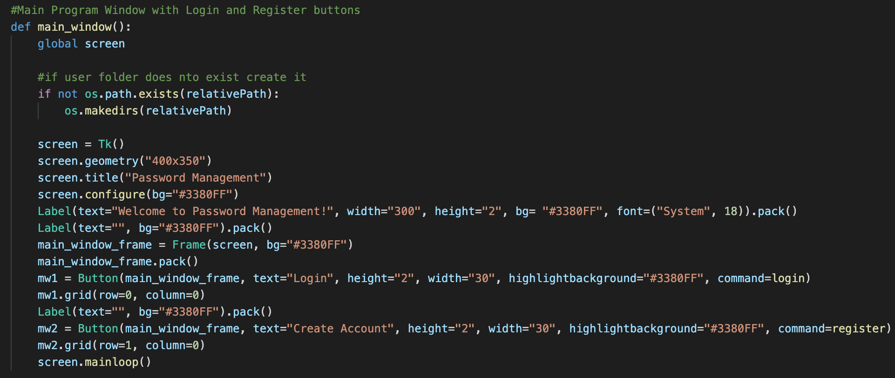
GUI Code

Slide 5
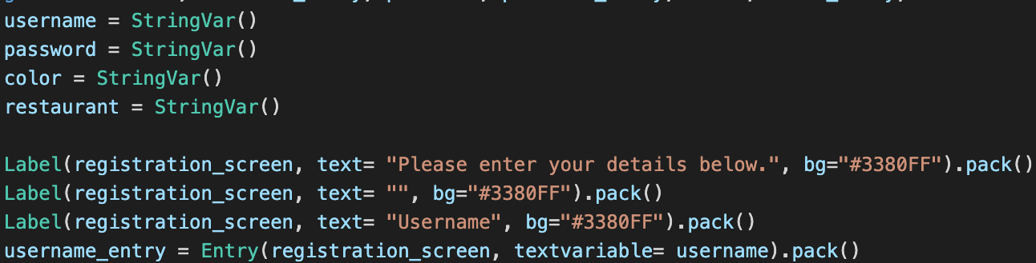
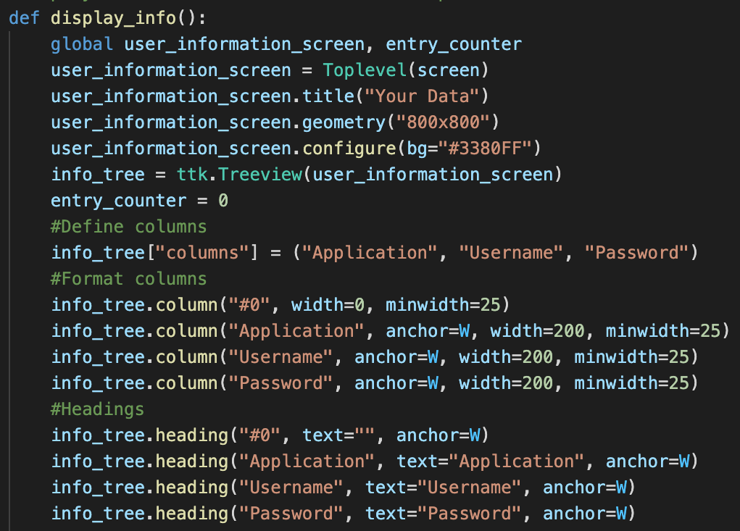
GUI Code(cont.)

Slide 6
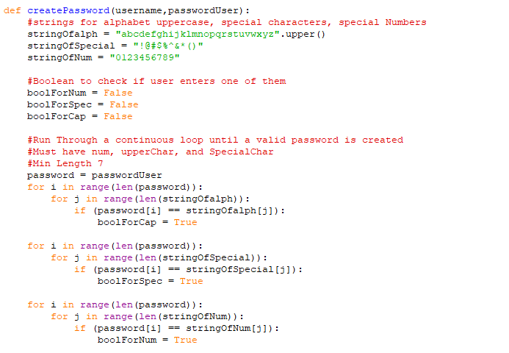
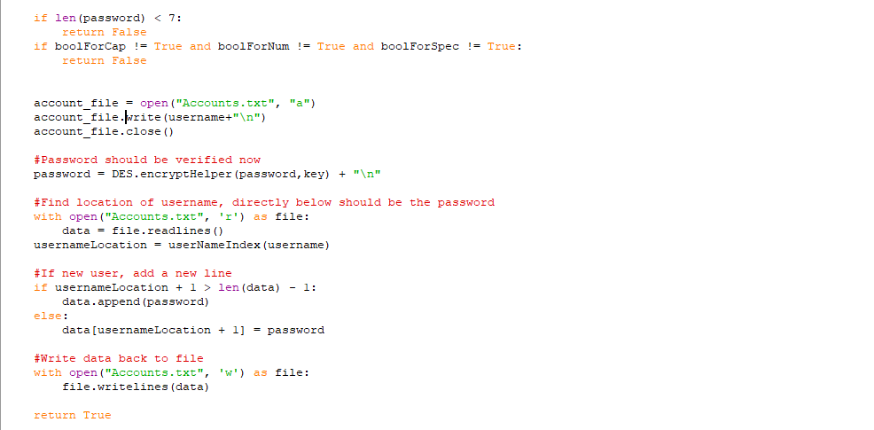
Password Logic
Notes:
Brain Nguyen

Slide 7
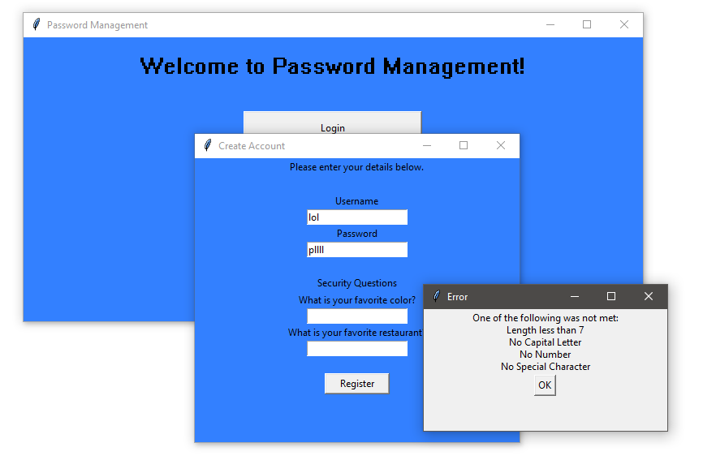
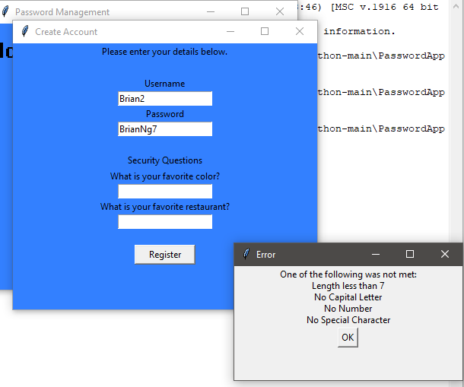
Password Failure Invalid

Slide 8
DES
Graphics form Geeks For Geeks and Chirag Bhalodia

Slide 9
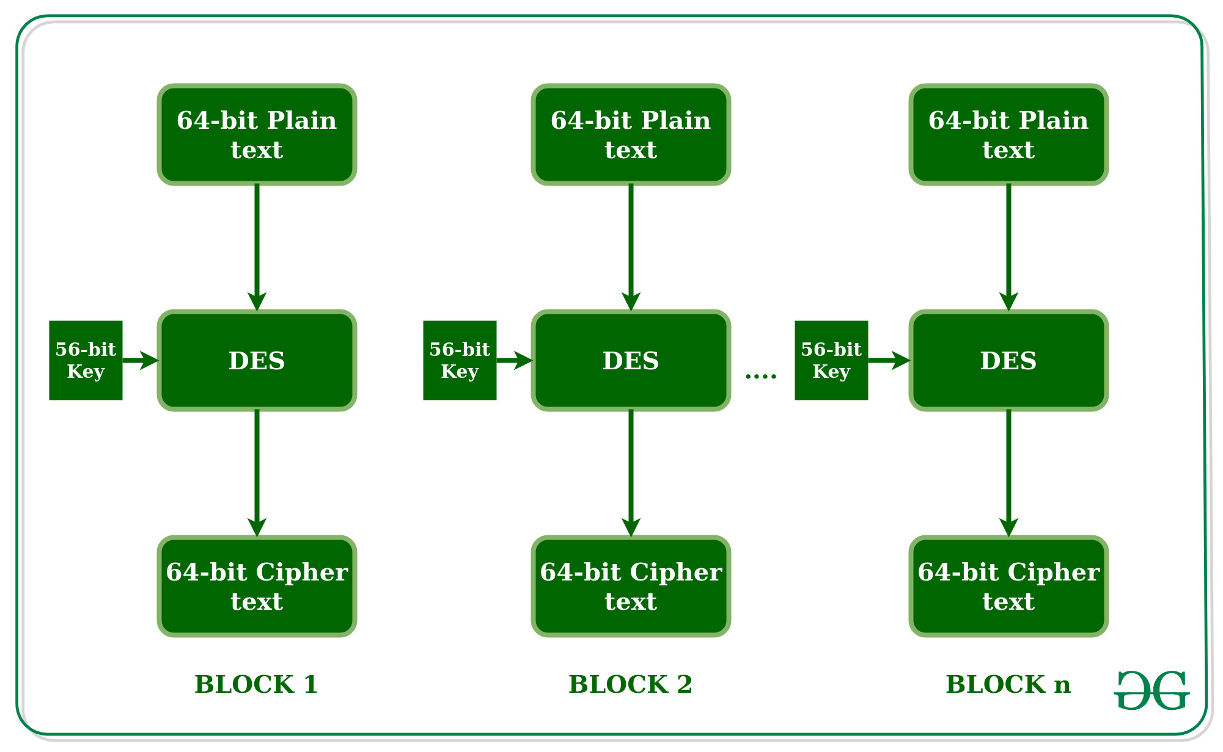
Block Chain
Notes:
Explain why 64b key compressed to 56 bit

Slide 10
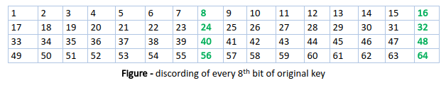
Key Transformation 64 Bit to 56 Bit

Slide 11
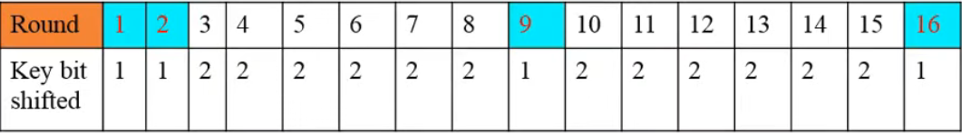
Circular Left Shift

Slide 12
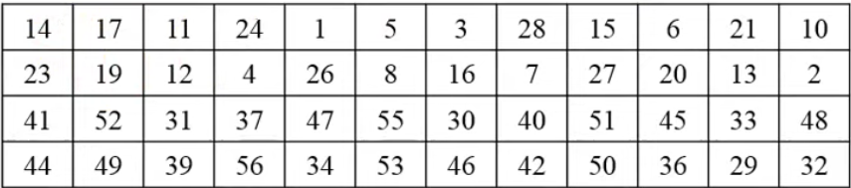
Compress Key 56 Bit 48 Bit
9, 18, 22, 25, 35, 38, 43, 54

Slide 13
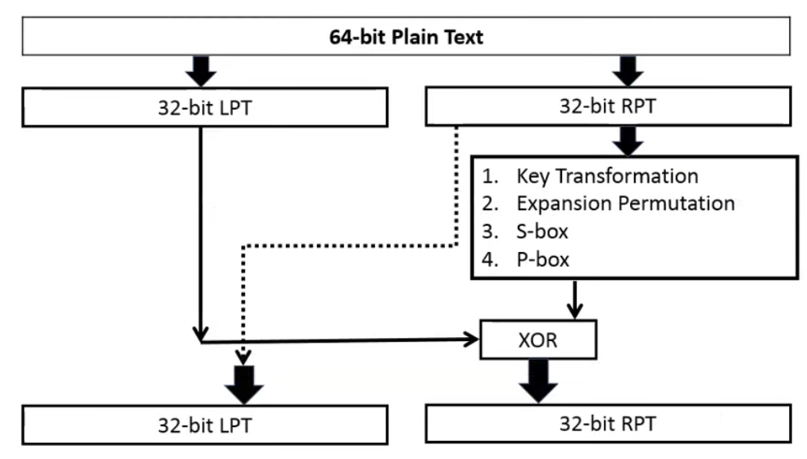
Feistel Cipher

Slide 14
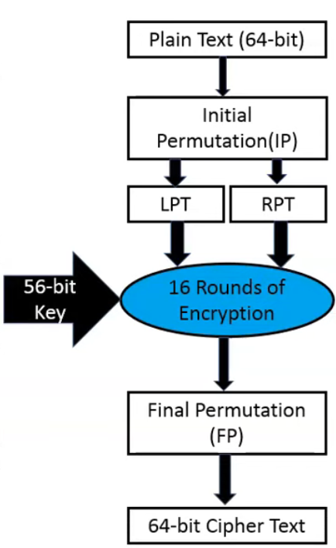

Slide 15
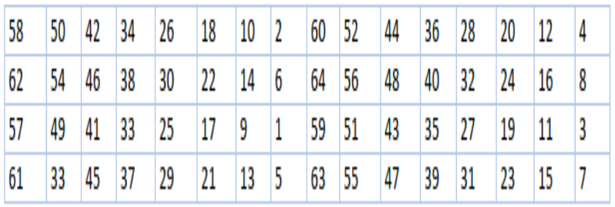
Initial Permutation

Slide 18
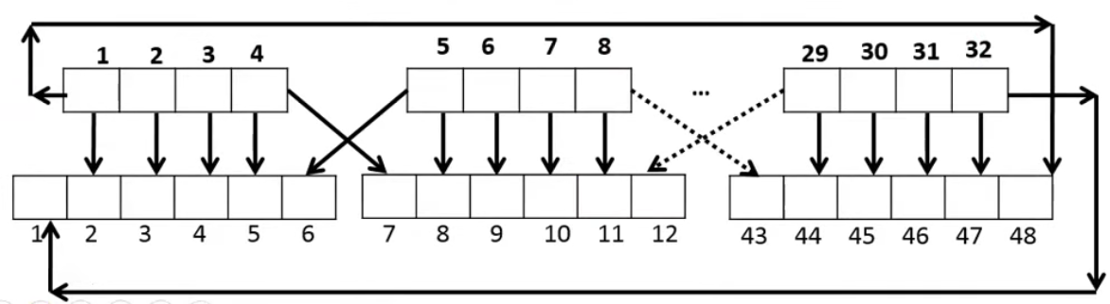
Right Plain Text Expansion 32 Bit To 48 Bit

Slide 19
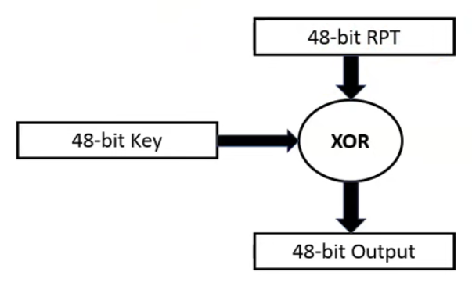
XOR 48 Bit Key

Slide 20
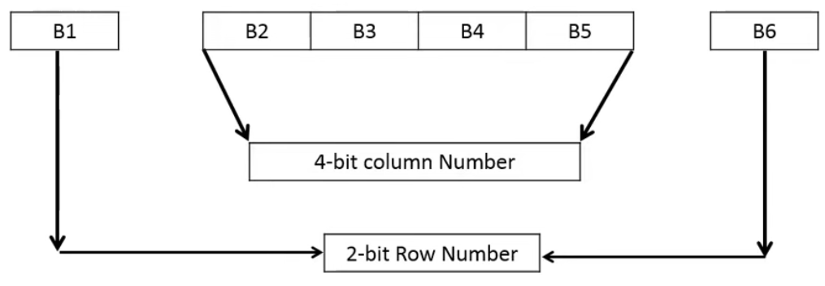
48 Bit to 32 Bit (S - Box)

Slide 21
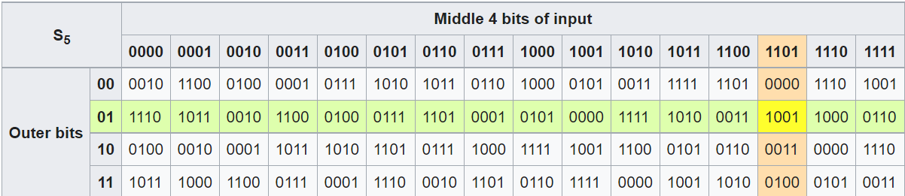
S Box Example (5th Bit Block)

Slide 22
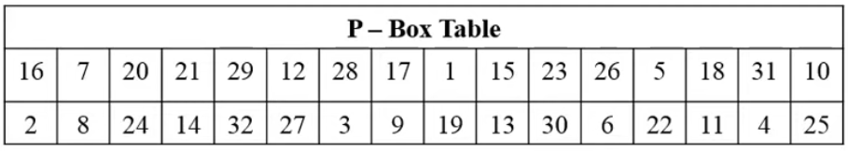
Permutation

Slide 23
XOR and Feistel Cipher

Slide 25
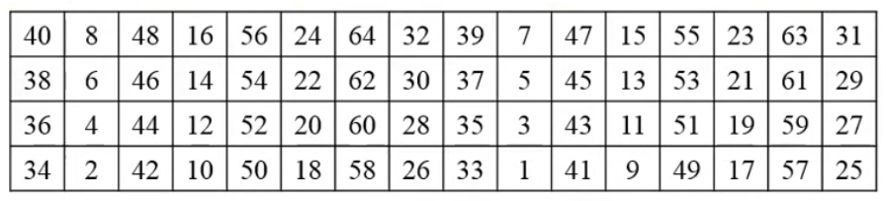
Final Permutation

